Slide 1
Securing the AI Frontier: Protecting Assets from Intelligent Agents

Slide 2

Agenda:
Generative AI vs Agentic AI
Demo: How to create AI agents in Python
What are MCPs?
What are RAG Models?
Challenges using Agentic AI Models
Demo: Vulnerable AI Models
Can AI agents Act as Threat Actors
Guardrails for AI agents

Slide 3
Gen AI vs Agentic AI
The discussion around ChatGPT (Generative AI), has now evolved into Agentic AI.
While ChatGPT is primarily a chatbot that can generate text responses, AI agents can execute complex tasks autonomously e.g., plan a trip, make a flight booking etc.
Generative AI
Agentic AI
Task
Agent
ACT
Intermediate Output
Response
Prompt
LLM
Generates Text, Images, Videos
Data
Memory
System Tools

Slide 4

How to Create AI Agents?
DEMONSTRATE HOW TO CREATE AI AGENTS

Slide 5
Model Context Protocols
The Model Context Protocol (MCP) addresses this challenge by providing a standardized way for LLMs to connect with external data sources/tools. Creating a universal, plug-and-play format where any AI app can use any tool without custom integration code.
Protocol handshake:
Initial connection: When an MCP client starts up, it connects to the configured MCP servers on your device or applications.
Capability Discovery: The client asks each server "What capabilities do you offer?" Each server responds with its available tools, resources, and prompts.
Registration: The client registers these capabilities, making them available for the AI to use during your conversation.
All communication in MCP uses JSON-RPC 2.0 as the underlying message standard

Slide 6
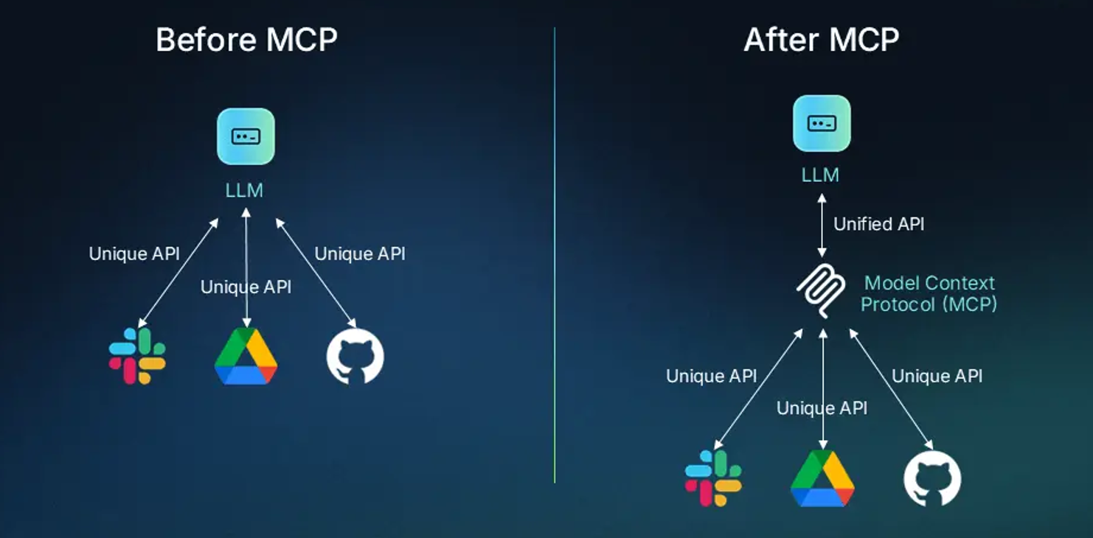
MCP: Example Workflow

Slide 7
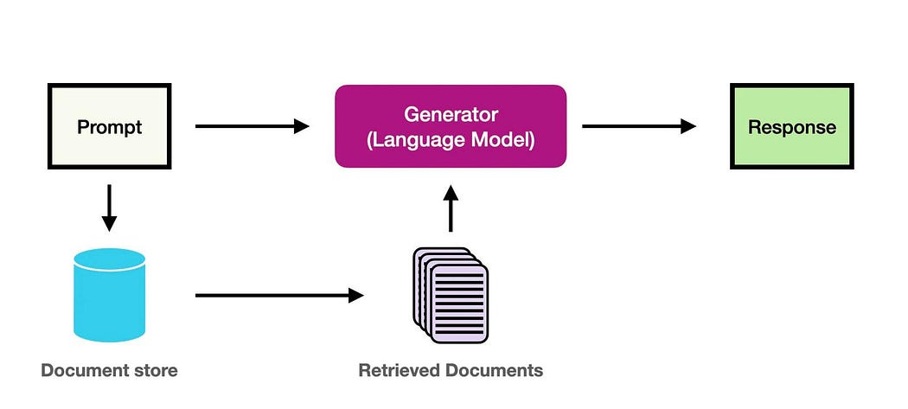
RAG: Retrieval Augmented Generation Models
The primary purpose of a Retrieval-Augmented Generation (RAG) model is to enhance the accuracy and contextual understanding of Large Language Models (LLMs) by integrating external knowledge sources into the models.

Slide 8

Poorly Designed AI Agents:
DEMONSTRATE HOW TO EXPLOIT INSECURE AI AGENTS

Slide 9
Challenges when using AI Agents:
Security by Design/Lack of Creativity: Uses public repositories to gather information and develop code, if a code is vulnerable then it’s a high probability that AI agent will use the Vulnerable code to complete the task.
In case of 0-Day attacks AI models take time to update their database and provide relevant information.
Privacy Concerns and Long-Term Memory Threat when providing additional access and tool capabilities.
Lack of Ethics as since it works most algorithms so it can be misused easily.

Slide 10


AI Agents as a Threat Actor:
Intellectual Data Thefts
Backdoor Attacks causing model act Maliciously
Extended Capabilities for AI Tool and Plugins
Impact Supply Chain Security for App Components

Slide 11
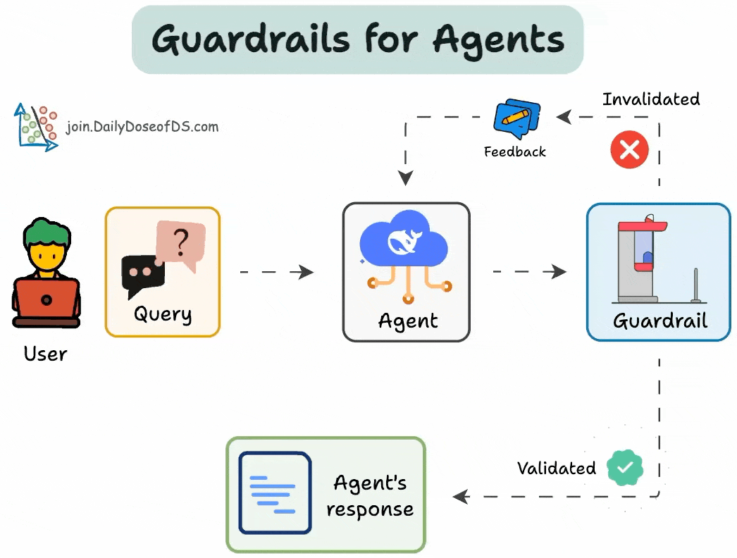
Guardrails for AI Agents
Implement Data Handling and Data Validation
Role Based Access Controls
Limit Extra Application Tools Capabilities
Review Training Data
Logging and Monitoring of Model responses
Rate Limiting's

Slide 12
